Slide 1
DISEASE-SPECIALIST PREDICTION USING MACHINE LEARNING
TEAM : NOOB ENTITY
Mentors : Mr. Abhimanyu Kolakotla, Mrs. Navaneetha
NSS COLLEGE OF ENGINEERING,PALAKKAD
25/11/2021

Slide 2
MEMBERS
SREYA S
KAVYA K
ABHIJITH K
PRANAV K S
MIDHUN KRISHNAN T
SREEDEVI UNNI
C DEVIKA

Slide 3

PROBLEM STATEMENT
People who have less knowledge about diseases and its symptoms find it difficult to predict the disease and the doctor specialist they have to consult.

Slide 4
SOLUTION
A Standalone application that takes 5 symptoms as input.
Based on the 5 symptoms, the disease and the specialist doctor that the patient has to consult will be predicted
The Machine Learning Algorithms such as Random Forest, K-Nearest Neighbor, Naive Bayes, Decision Tree algorithms are used

Slide 5
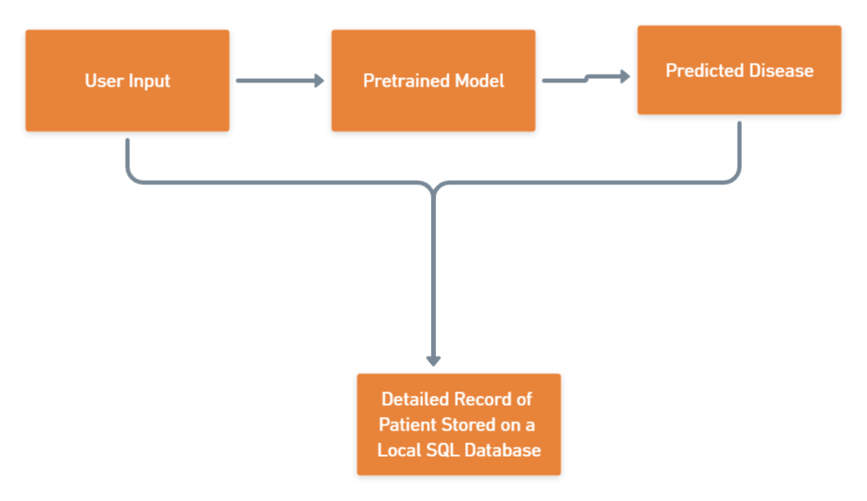
BLOCK DIAGRAM

Slide 6
THANKYOU

